Slide 1
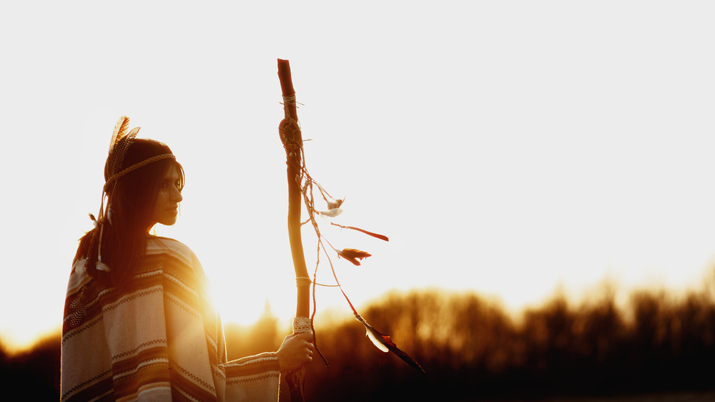
Maamwi Noojimodaa (let’s heal together): Indigenous-led and survivor-led efforts to address the crisis of Missing and Murdered Indigenous Relatives (MMIR)
Dr. Jeneile Luebke PhD, RN
Assistant Professor- Nursing
University of Wisconsin- Madison
Notes:
I want to begin by expressing my deep appreciation for the privilege of gathering and being present with you to share this time and this space—to give my thanks to the Elders, to the grandmothers, to the grandfathers,

Slide 2

Ojibwe Welcome
Bozhoo Kinaweya!
Ogimaakwe n’dizhinikaas
Ajijaak ndoodem n’daa aw
Mashkii Ziibiing n’doonjibaa

Slide 3
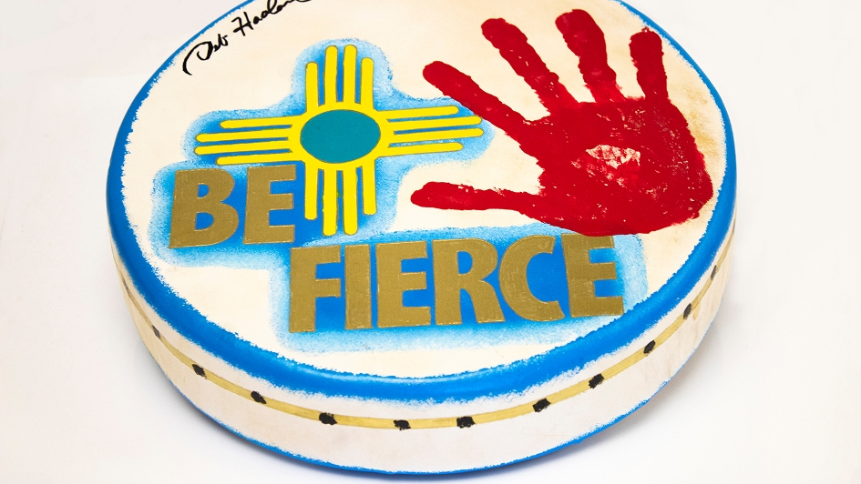
Positionality
Urban Indigenous woman (Ancestry: Bad River, St. Croix, LCO, French/ German (Enrolled Bad River)
20+ years of nursing experience: peds/ acute/ public health/ women’s health
RN, CNS-P, PhD- Nurse researcher/ knowledge seeker & gatherer/ educator
IPV survivor- PhD program and advocacy/ activism work has been a healing journey for me
Research topic: Intimate partner violence/ trauma/
Notes:
As mentioned in the title, my presentation today is about topics that can activate trauma if you have a history (intimate partner violence, trafficking, MMIW) . Please step out and take care of yourself if you need to.
DISCLAIMER- FEMINIST PERSPECTIVE (my focus is self-identified women who have experienced IPV by men) → I will explain more in my research slides

Slide 4
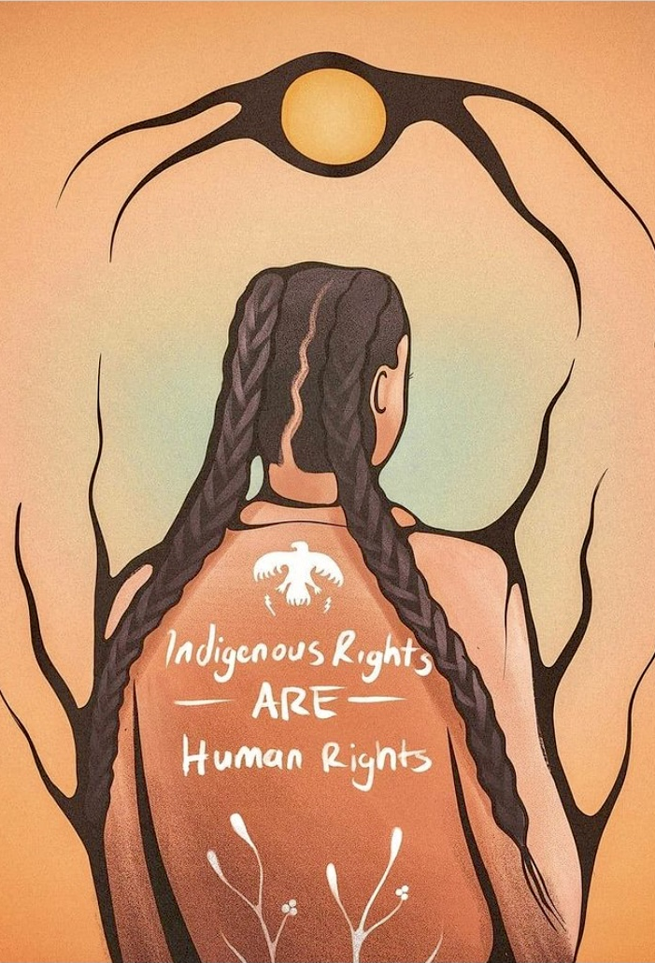
Honoring our stolen sisters & survivors
It is a privilege and honor to be here- we are creating safe spaces together to heal and grow!
I am here to center and honor the voices that have been silenced
I am here on behalf of my community, my family, and for survivors of violence
For those who are no longer here- our silent guests who are here with us in spirit
These conversations can be difficult… but nothing changes if nothing changes!
Notes:
I want to begin by expressing my deep appreciation for the privilege of gathering and being present with you to share this time and this space—to give my thanks to the Elders, to the grandmothers, to the grandfathers,
MMIW/ MMIR awareness is a grassroots effort

Slide 5
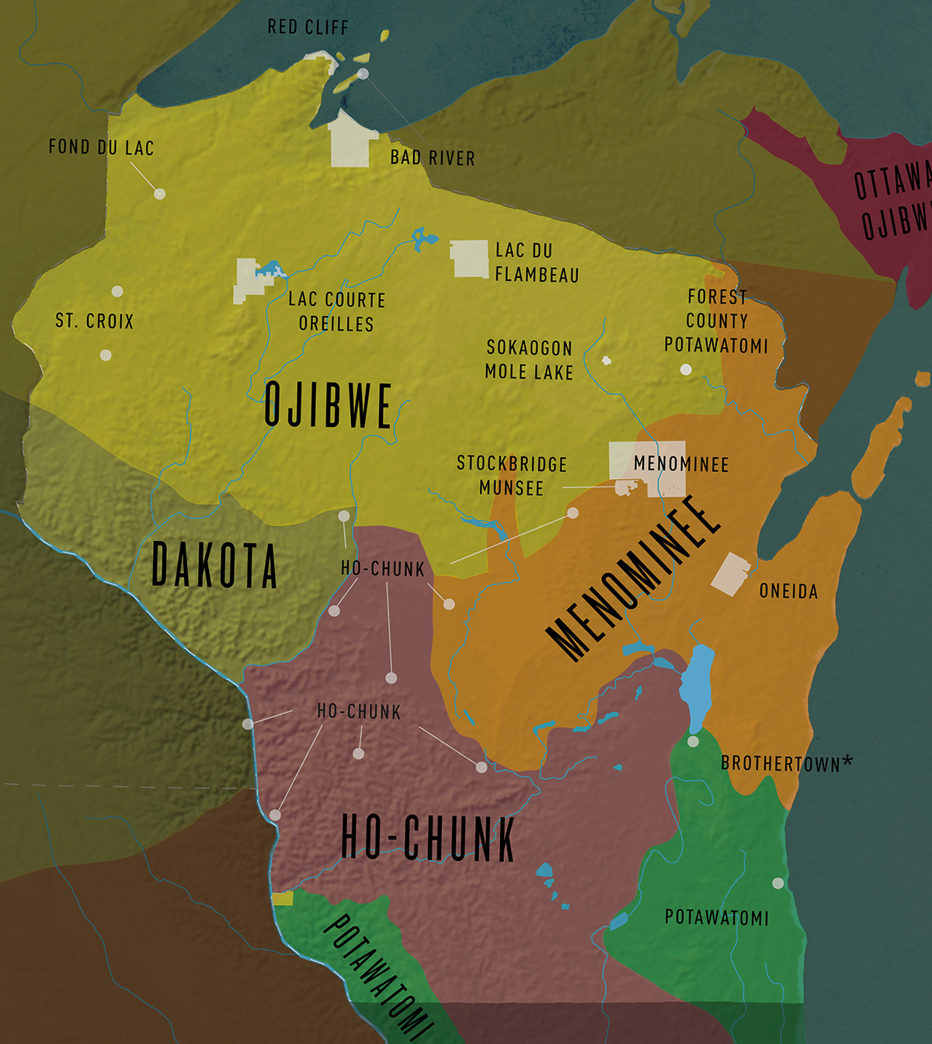
Wisconsin tribes
Wisconsin: 11 federally recognized tribes: Bad River Band of Lake Superior Chippewa, Ho-Chunk Nation, Lac Courte Oreilles Band of Lake Superior Chippewa, Lac du Flambeau Band of Lake Superior Chippewa, Menominee Tribe of Wisconsin, Oneida Nation, Forest County Potawatomi, Red Cliff Band of Lake Superior Chippewa, St. Croix Chippewa, Sokaogon Chippewa (Mole Lake), and Stockbridge-Munsee, in addition to a non-federally-recognized tribe (Brothertown Nation).

Slide 6
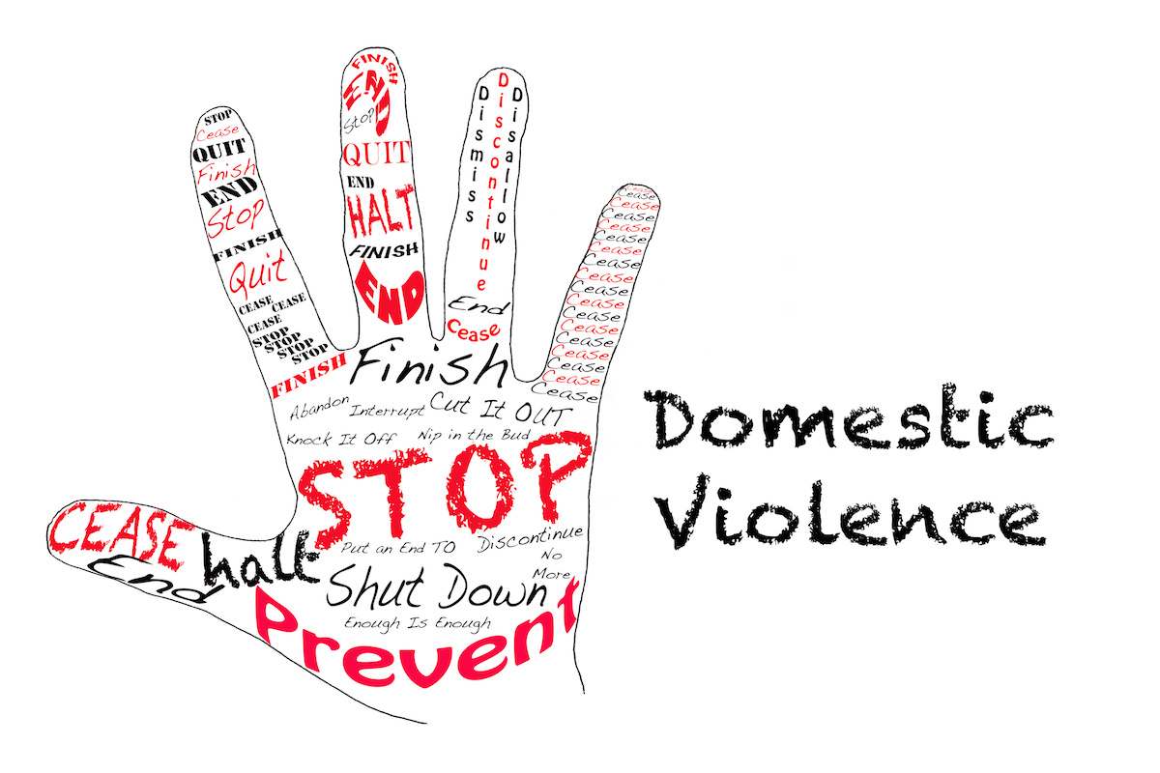
The intersection of intimate partner violence (IPV), sexual assault, human trafficking, and MMIW
Gender based violence & femicide
Notes:
What this talk is about today- my work as a nurse researcher and scholar

Slide 7
Why is this important?
Impacts of GBV
Physical injury (including strangulation)
Death: Homicide, suicide, or maternal
mortality related to high-risk pregnancy
Risk of STIs and HIV
Chronic pain or frequent illness
Psychological: depression, PTSD, drug and alcohol abuse, eating disorders, sleep disturbances
Decreased productivity/ missed work and school
Notes:
How I became involved with this movement
I want to quickly highlight the importance of discussing this topic. Yes, it is a highly sensitive topic. But we know from the data that many of our sisters are suffering, and most of the time, in silence.
Silent epidemic- prevalence rates are estimated and likely MUCH higher because many times IPV/ stranger rape is NOT reported to authorities (only 20% reported)

Slide 8
Gender Based violence
Gender based violence (GBV) is one of the most serious public health issues occurring in Indigenous communities today.
Violence against Indigenous women is higher than any other racially defined group (Finfgeld-Connett, 2015).
According to the 2016 National Intimate Partner and Sexual Violence Survey (NISVS) report conducted by the NIJ, up to 84.3% of Indigenous women have experienced violence in their lifetime (Rosay, 2016).
Indigenous women also experience one of the highest rates of homicide in the US. Nearly half, or 46.6% of AI women who were murdered were victims of IPV (Petrosky, Blair, Betz, Fowler, Jack, & Lyons, 2017).
Many of the perpetrators of IPV and sexual violence against Indigenous women are non-Native men (86%)*
Notes:
NISVS- The National Intimate Partner and Sexual Violence Survey (NISVS) is an ongoing survey that collects the most current and comprehensive national DV data
Native Americans (American Indian/ Alaskan Natives)
NA represent about 1% of the US population
Women of all ages, ethnicities, and socioeconomic backgrounds can become victims of violence, however, the incidence of violence against women is greatest among Native Americans than any other racially defined group.

Slide 9

Missing and murdered indigenous relatives
Impacts Indigenous peoples in Canada, New Zealand, Australia and the US (and in other indigenous populations globally).
The National Crime Information Center reported that in 2016 there were 5,712 reports of missing Indigenous women and girls (NamUS only logged 116 of these cases)
From 1999 to 2019, homicide was the third-leading cause of death among American Indian and Alaska Native women and girls ages 12 to 30, according to data from the Centers for Disease Control and Prevention
Exact numbers unknown (Estimated 25,000+ since1900)
Indigenous women/ relatives living on tribal lands are murdered at 10x the national average (NIJ).
Indigenous women/relatives are NOT just “disappearing into thin air”!
Erasure from life and in the media!
Notes:
Although the federal government keeps data on virtually everything, it does not collect statistics on missing and murdered Native women, has no national database where tribes can report such crimes, no way for families or tribal investigators to seek information (Sovereign Bodies Institute)
NamUS= Only 116 of the women in the FBI's accounting were logged into NamUS (the Department of Justice's federal missing persons' database, a resource that allows law enforcement agencies to share information).
Exact number of IWG who have gone missing or have been murdered in US is unknown- estimates ranging from approximately 5,000-7,000 (equivalent of 30,000 white women).
It has been estimated that if we went back since 1900, it is likely around 20,000.
Native citizens are 6.7 percent of the population, yet between 2016 and 2018, they made up 26 percent of the state’s missing persons cases (WHAT STATE)
Canadian police have. found that IW -4 percent of Canada's female population- made up nearly 25 percent of its female homicide victims in 2012.

Slide 10
How did we get here?
intersecting systems of oppression & Root causes

Slide 11
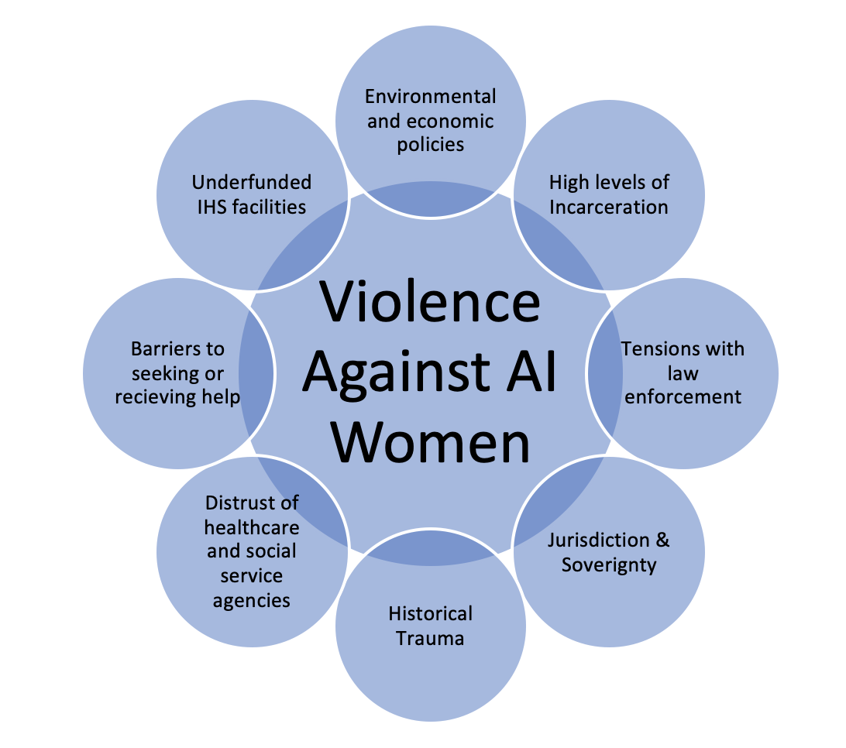
Root Causes:
Intersecting Systems of Oppression
Notes:
Indigenous peoples have experienced centuries of atrocities such as colonization resulting in health disparities that remain today (forced migration, rape, slavery, reservations, boarding schools, treaty violations, racism, forced sterilization, poverty, etc etc).
Intended and unintended consequences of federal termination and assimilation policies- policies put into place to oppress and erode sovereignty
Residual effects of colonization, historical trauma, patriarchy, intergenerational trauma and the ongoing racism and structural violence
Lack of trust with outside and tribal agencies/ Normalizing violence
Centuries of sexual violence that starting during colonial times (trafficking)
Colonialism (action and inaction), historic racism, discrimination, exclusion, and marginalization (political, economic and social spheres)
Harmful assumptions and stereotypes of American Indians
Complex web of oppressive federal laws/ statutes have disempowered tribes/ erosion of Sovereignty (inherent right to self-govern)
Layers of oppression (AI and being women)

Slide 12

Roots of violence against Indigenous women: violence is NOT traditional
Indigenous ways of knowing: violence against Indigenous women is NOT traditional
Indigenous women are sacred, givers of life, and valued, and cherished
Indigenous women held positions of power and fought alongside men in battle
Women were and still are an integral part of peacekeeping and the balance of life
IPV and SA was RARE in pre-colonial times, and was dealt with swiftly by tribes
Notes:
MOVING INTO THE WHY
In pre-colonial times, tribes were egalitarian or matriarchal.
IPV would have been dealt with by banishment, restitution/ restorative justice
Early suffrage leaders/ allies envied this egalitarian society which helped them recognized the imbalance of power and oppression of patriarchy, which was the impetus for the suffrage movements.

Slide 13
Violence is NOT Traditional con’t
Centuries of trafficking sexual violence that starting during colonial times
Colonialism (action and inaction), historic racism, discrimination, exclusion, and marginalization (political, economic and social spheres)
Harmful assumptions and stereotypes of Indigenous peoples
Layers of oppression and barriers to help seeking
Indigenous women were sexualized by colonizers/ misogyny
Indigenous women’s voices silenced (no one will help me, no one gets arrested, so why bother)
Notes:
Centuries of sexual violence that starting during colonial times (trafficking)
It has been documented by missionaries that Christopher Columbus raped and trafficked Native women
AI women were sexualized by colonizers/ misogyny
AI women’s voices silenced (no one will help me, no one gets arrested, so why bother)
The Disney (colonizer) story of “Pocahontas” is based from Matoaka- a child victim of trafficking (taken from her family and used as a sex slave for white men).

Slide 14
Violence against Native Women
Major Crimes Act (1885)
Dawes Act
(1886)
Indian Relocation Act (1956)
Oliphant vs. Suquamish (1978)
Boarding Schools
(1860’s-1978+)
Termination and assimilation policies
Notes:
The phenomenon of violence against Native American women is a highly complex issue with deep roots in historical trauma, structural violence, cultural issues, and also issues of jurisdiction and sovereignty
I will quickly review some of these assimilation and termination policies in the next few slides. It is important to understand the sociopolitical history and contexts that occurred to better understand the consequences that we still see today.
Power and control- oppressor/ oppressed (disempower)

Slide 15
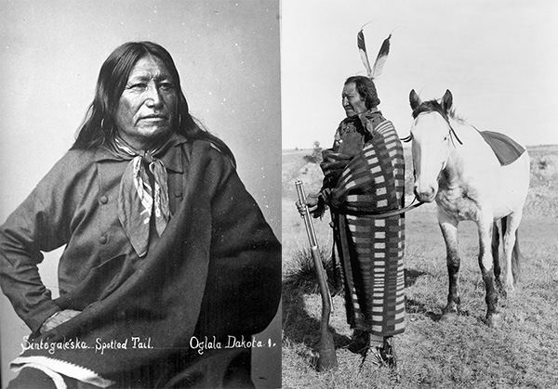
Ex parte crow dog
Original jurisdictional conflict between sovereign tribes and federal authorities (1881)
Considered a legal atrocity, showing the "savage" quality of tribal law, and setting the stage for tribal "dependency" on the US legal system
Notes:
On August 5, 1881, Crow Dog shot and killed Spotted Tail (both Lakota Sioux men) on tribal land. The tribal council dealt with the situation according to Sioux tradition (Crow Dog was ordered to take care of Spotted Tail’s family and could no longer be a part of official tribal affairs)
Neighboring communities were outraged and demanded justice by hanging
Crow Dog was ultimately released and federal authorities acknowledged that he could not be tried a second time.
The irony of this is that colonizers thought that Natives were savages and backwards, yet our current day government structure was founded on principles of the Iroquois confederacy, which was highly organized and unified tribal government system between the (Mohawk, Seneca, Oneida, Cayuga, and Tuscarora) -→ their democratic principles were incorporated into the constitution itself

Slide 16
Major crimes act
Sparked by Ex Parte Crow Dog
Federal law passed in1885 that places certain crimes under the federal government’s jurisdiction if they are committed by a Native American on tribal land
The law initially applied to seven major crimes, and the number now has grown to 15, including murder, manslaughter, burglary, robbery and felony child abuse and neglect.
This was a steppingstone to erosion of tribes’ inherent right to self-govern. Tribes were viewed as “savage” and “barbaric” and unable to self-govern

Slide 17
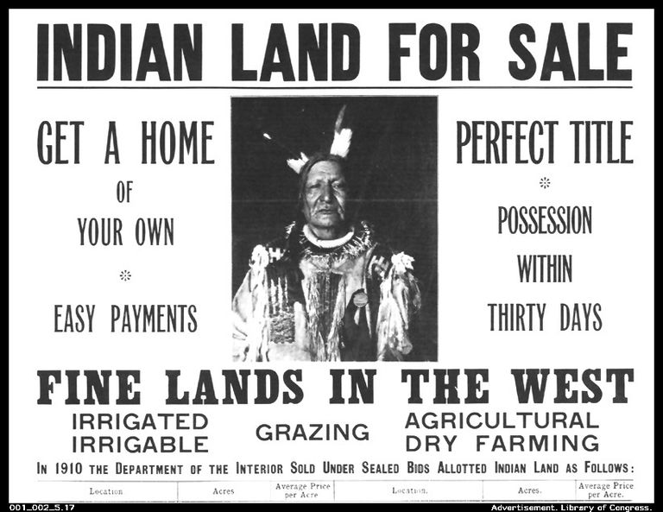
Dawes Act
The Dawes Act was a U.S. law enacted in 1887 that resulted in the sale of over 90 million acres of American Indian owned tribal land to non-Indians for the purpose of assimilating American Indians into white society (and for attaining valuable natural resources)
“Manifest destiny”
Dawes roles- what tribal “blood quantaum” amd member ship based from (lots of inaccuracies)
Notes:
This federal policy intended to assimilate Indians into white U.S. society by encouraging them to abandon their tribally-owned reservation lands, along with their cultural and social traditions.
Signed into law by President Grover Cleveland.

Slide 18
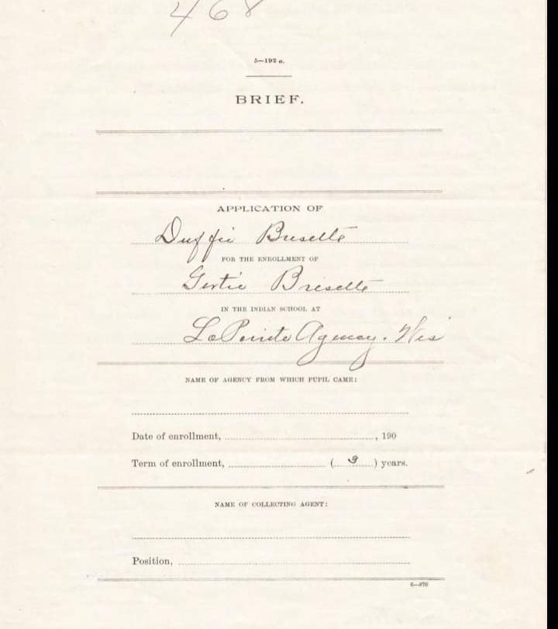
Boarding schools
Attempt at assimilation of Natives by the US government from1860’s-1978
Native children were taken from their parents and stripped of their culture and ways of life, forbidden to speak Indigenous languages, (rid them of their savagery)
Carlisle was larges and most known (1879-1918). Over 10,000 children from 150 tribes attended.
The government also paid religious orders to provide basic education to Native American children on reservations in the late 19th and early 20th centuries, with the last residential schools closing as late as 1973.
(My great great Aunt Gertie’s paperwork for Carlisle boarding school from 1911-1914)

Slide 19

Public Law 280
PL-280 was enacted by the federal government in 1953
The law altered criminal jurisdiction on Indian reservations across the country, removing the federal government's authority to prosecute crimes involving Native Americans and giving certain states the ability to prosecute criminal offenses only
Congress gave six states (five states initially - California, Minnesota, Nebraska, Oregon, and Wisconsin; and then Alaska upon statehood) extensive criminal and civil jurisdiction over tribal lands
Public Law 280 is a complicated statute, which has been very controversial since the time of its enactment in 1953. It has often been misunderstood and misapplied by both federal and state governments.
Menominee Nation (Wisconsin) exempt from PL-280
Notes:
On Menominee reservation, we have our own jail, we have our own court system, our own parole officers, our prosecutors. So we adjudicate all altercations or conflicts with tribal members within the reservation."

Slide 20

Oliphant vs. Suquamish
Mark Oliphant (non-Native) assaulted a tribal Suquamish police officer in 1973. He challenged his arrest.
The case went to the US Supreme court and the court agreed with him in 1978.
As a result,. Native courts do not have the authority to prosecute non-Natives for crimes that occur on tribal lands.
This has been the biggest turning point leading to increases in violence (on reservation-based areas)
(This ruling continues today. The VAWA has restored some of these inherent rights)
Notes:
He didn't think that he should be held accountable because he was white.
This is MAJOR since 78.8% of acts of violence against Native women are perpetrated by non-Native men
VAWA discussed in an upcoming slide

Slide 21
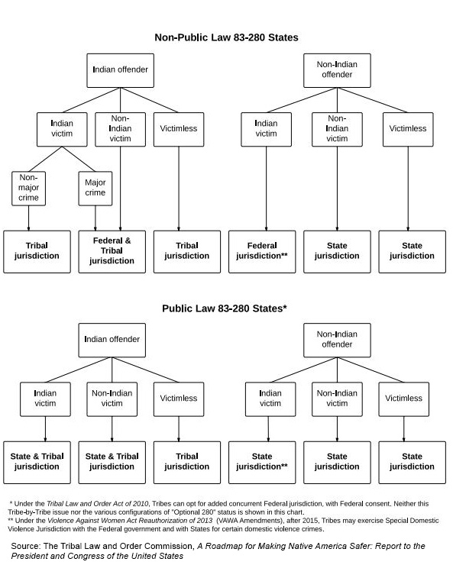
Notes:
Jurisdictional Chart- very complex and varies by State (PL-280)
Wisconsin is one of 7 PL-280 states (even within PL-280 states, some tribes are exempt. Example: Menominee Nation).
Since Oliphant in 1978, federal, tribal, and state agencies split jurisdiction. So when a crime occurs, it can be complicated to figure out who is supposed to lead the investigation.
Say a Native woman is sexually assaulted. Where did it happen? On the reservation or off? If her attacker is Native, and it occurred on the reservation, then tribal police and courts have jurisdiction. If her attacker is non-Native, then the FBI or state investigates. If she is assaulted off the reservation, the state is supposed to act.
As for felonies like murder, rape, and kidnapping, if they happen on tribal lands, the Department of Justice is supposed to prosecute—but it often doesn't. In recent years, the Department of Justice has pursued prosecution in only about half of murder cases on reservations and in a little over a third of cases of sexual assault. In 2017, under mounting pressure to address this crisis, the department still declined more than one-third of cases referred to them by reservation authorities.

Slide 22
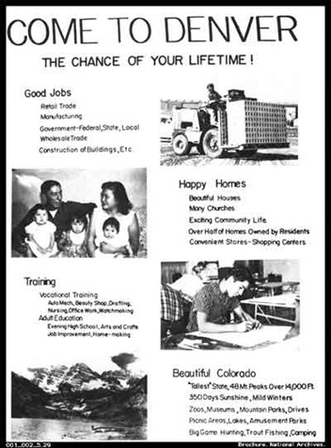
Indian relocation act
The Indian Relocation Act of 1956 (also known as Public Law 959 or the Adult Vocational Training Program) was a US law intended to encourage Native Americans in the United States to leave Indian reservations, acquire skills, and assimilate into the general population (1952-1972)
Around 100,000 American Indians relocated to cities in the US with promises of a “better life”. It was basically a one-way ticket to urban poverty and hardship.
Notes:
Another example of a patriarchal policy to assimilate (they’ll be better off in the city)

Slide 23
Consequences of limiting tribal sovereignty
Indigenous women remain targets of sexual violence and trafficking
Jurisdictional confusion and lack of prosecution
Lack of collaboration between federal/ local/ tribal authorities and agencies
Lack of reporting of crimes
Crime data on reservations/urban areas lacking (underreporting of crimes between tribal/ local/ state/ federal authorities)
Gaps/ loopholes in the VAWA
Notes:
VAWA:
Is it working?
18 of the 573 federally recognized tribes became voluntarily compliant with the federal regulations
143 arrests of 128 different non-Indian abusers. These arrests have led to 74 convictions and 5 acquittals to date, with some cases still pending.
Tribes must adhere to ”due process” just as any court (provide a court appointed council to defend those who cannot afford one, right to a fair trial, jury of native and non-native members, etc)- HAS BEEN A MAJOR CHALLENGE
Major crimes still handled by FBI and US Attorney’s offices- still confusion of jurisdiction/ poor record keeping/ racism

Slide 24
Contemporary contexts in MMIW Crisis
A continuation of colonial injustice:
Continued tensions with social service agencies, foster care system and challenges to ICWA
Intergenerational trauma/ family dynamics
  Human Trafficking
  Sex work- impacts highly vulnerable
  Youth runaways
Forced Sterilization (70’s in the US and up until 2017 in Canada).
Distrust of healthcare services and providers
Barriers to help seeking- MANY!
Tensions with law enforcement/ mass incarceration
Underfunding of Indian Health Service
Invisible in the data/ invisible in the media
Notes:
Forced sterilization: The Family Planning Services and Population Research Act of 1970- approximately 25% (or more) of AI women sterilized (not by exercising their reproductive rights)! Coersion and forced consent- threatening to take away children if no consent. This was by IHS physicians and nurses!
Violence against the land (next slide)

Slide 25
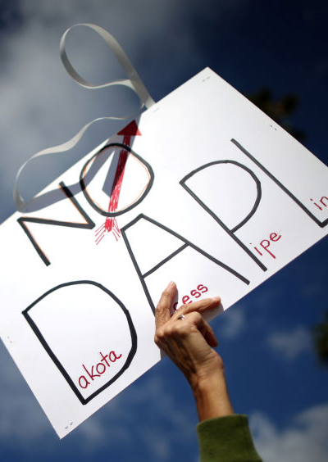
Violence against the land= violence against Native women
Perpetuation of colonial settler influence, patriarchy, and capitalism (clash of values)
  Western view: ownership, property, real estate, wealth
  Native view: connection, belonging, family, Mother earth feeds and sustains
Energy policies have directly contributed to further land degradation and increases in violence against women (in US and globally)
Several proposed pipeline/ mining projects in Wisconsin that would disproportionately impact tribes
Man Camps
Notes:
Valuable (Native) land resources as a driving force behind land degradation: oil and natural gas pipelines, mining, fracking, and tar sands (Trans Canada Coastal GasLink/ Dakota Access Pipeline/ Keystone XL)
Natives did not (and do no) acknowledge the land as “theirs” for purposes of financial or personal gains. Land is sacred because it is critically tied to our ability to carry out our traditional practices. Without our land, our culture weakens
Land grabs (Landmark case of Oklahoma July 2020): The Supreme Court ruled Thursday that about half of the land in Oklahoma is within a Native American reservation, a decision that will have major consequences for both past and future criminal and civil cases. The ruling will have significant legal implications for eastern Oklahoma. Much of Tulsa, the state's second-largest city, is located on Muscogee (Creek) land
MAN CAMPS
Invisible in the media
Back Forty Project. The proposed mine, headed by Canada-based Aquila Resources, would process gold, zinc, copper, silver and other minerals the Upper Peninsula of Michigan, which happens to be part the Menominee Tribe's original ceded territory. The mine would be located along the Menominee River and the interstate boundary waters between Michigan and Wisconsin

Slide 26
What to do?
Interventions to address the crisis of MMIW/ relatives

Slide 27
Federal and state efforts
Federal MMIW Task Force
Savannah's Act
Violence Against Women Act
Not Invisible Act
Wisconsin MMIW/ MMIR
Notes:
Savanna’s Act, S.227, was originally introduced in 2017 by Senator Heidi Heitkamp after the horrific murder of Savanna LaFontaine-Greywind, a pregnant member of the Spirit Lake Tribe. Senator Lisa Murkowski reintroduced the bill in 2019, and it was passed by the Senate in March 2020. Savanna’s Act clarifies federal, state, tribal and local law enforcement responsibilities with respect to missing or murdered Indians; aims to increase communication and coordination between federal, tribal, state, and local law enforcement agencies; improves tribal access to resources and information such as the federal criminal information databases needed to respond effectively to missing and murdered Indian cases; requires data collection related to missing and murdered Indian people, regardless of where they reside; and directs U.S. attorneys to develop regionally appropriate guidelines for responding to missing or murdered Indians.
The Not Invisible Act, S.982, introduced in April 2019, is intended to “increase intergovernmental coordination to identify and combat violent crime within Indian lands and of Indians.” The Act establishes a Joint Commission on Reducing Violent Crimes Against Indians of local, tribal, and federal stakeholders from diverse geographic areas that will make publicly available recommendations to the Departments of Interior and of Justice on best practices both departments can take to combat disappearances, murder, trafficking, and other violent crimes against Native Americans and Alaska Natives
The Missing and Murdered Indigenous Women Task Force (MMIW) is charged with helping fight the abduction, homicide, violence and trafficking of Indigenous women in Wisconsin. The task force plans to focus on examining the factors that contribute to missing and murdered Indigenous women (MMIW) and the response from social service organizations, understanding the roles federal, state and tribal jurisdictions play, and improving and implementing robust data collection and reporting methods

Slide 28
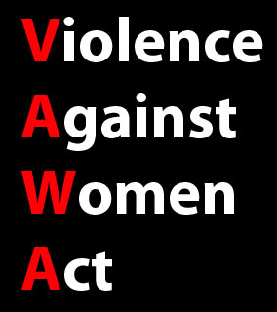
VAWA enacted in in 1994 improve criminal justice and community-based responses to domestic violence, dating violence, sexual assault and stalking in the United States
VAWA 2013 recognizes tribes' inherent power to criminal jurisdiction over certain defendants, regardless of their Indian/ non-Indian status, who commit acts of IPV or dating violence or violate certain protection orders on tribal land.
There are LIMITATIONS in the 2013 VAWA
Many gaps/ loopholes addressed in 2022 version
First time in 35 years that tribes can prosecute non-Natives for violent crimes
Still more work to do!
Notes:
Data collected in the late 1970’s and early 80s revealed that IPV was a problem due to the data from the NIJ studies
The newest version of VAWA, which passed in 2022- improvement from previous versions!!
The White House, 2013), contains specific tribal provisions to enable tribal authority to prosecute crimes against Native American women by non-Native perpetrators occurring on tribal land, but only in limited instances such as domestic violence, dating violence or violations of protection orders that occur on tribal lands
Differs from 2013 to include:
Expands tribal jurisdiction to include sexual assault, stalking and trafficking
Expands tribal jurisdiction to cover child abuse and other attendant crimes (children often concurrently abused or witnesses)
Improves data collection and response to missing and murdered women
Creates federal punishments for violating tribal exclusion orders
(Also includes protections for other vulnerable populations such as transgender and immigrants)
Is it working? (when are these stats from)?
18 of the 573 federally recognized tribes became voluntarily compliant with the federal regulations
143 arrests of 128 different non-Indian abusers. These arrests have led to 74 convictions and 5 acquittals to date, with some cases still pending.
Tribes must adhere to ”due process” just as any court (provide a court appointed council to defend those who cannot afford one, right to a fair trial, jury of native and non-native members, etc)- HAS BEEN A MAJOR CHALLENGE
Major crimes still handled by FBI and US Attorney’s offices- still confusion of jurisdiction/ poor record keeping/ racism

Slide 29

Other Legislative action
Seven states have formed task forces: New Mexico, Montana, Minnesota, Arizona, California and Nebraska, Wisconsin, & Utah.
Proposed funding for increases in funding for states (staff to solve cold cases, hire more tribal police, FBI)
2015 Tribal Access Program (TAC) implemented to increase tribes' access to National Crime Info Center (NCIC)
Notes:
Aside from the VAWA
TAC: As of 2019, only 47 of the 573 federally recognized tribes in the United States were participating in the TAC. That lack of access, due in part to the costs associated with updating computers, is critical. It means that many crimes go unreported, and tribal investigators who are called to a crime scene or who make traffic stops have a limited ability to pull up information on potential suspects. So many cases go uninvestigated, unsolved.

Slide 30
Wisconsin Indigenous led initiatives
Creation of SAFE SPACES for our relatives for healing, mobilization, and activism!
Menominee Nation Women’s Leadership Cohort (Menikanaehkem Community Rebuilders)
HIR Wellness Institute (Milwaukee)
Gerald Ignace Indian Health Care Center (Milwaukee)- Circles of Strength program
Wise Women Gathering (Green Bay)
Waking Women Healing Institute (Menominee)
Woodland Women (Menominee)
Healing Circles and advocacy
Notes:
Community activated medicine- the people are the medicine! (HIR Wellness)

Slide 31
Research as Ceremony
Research to help heal, connect, and mobilize rather than problematizing issues of injustice or producing fear
Indigenous researchers:
  How we acquire knowledge in our communities is just as critical for eliminating health disparities as the actual knowledge that is gained about a health problems
  Healing old wounds of distrust of academic institutions and researchers (relational)
  Continuously resolve conflicts between the values of the academic institutions and those of the communities
  Balancing the need to protect Indigenous knowledge while centering voices that have been silenced
  (Cochran et. al., 2005)
Notes:
Indigenous researchers are knowledge seekers who work to progress Indigenous ways of being, knowing and doing in a modern and constantly evolving context.
For researchers to be accountable to all our relations, we must make careful choices in our selection of topics, methods of data collection, forms of analysis and finally in the way we present information (healing and connection rather than further problematizing issues)

Slide 32
Current Research
National Institutes of Health (NIH), Native American Research Centers of Health (NARCH) grant in partnership with Great Lakes Intertribal Council (GLITC)
Mixed-methods, community-engaged pilot study builds on preliminary dissertation data using Indigenous methodologies to further identify, document, and understand the barriers to help-seeking among Indigenous women with co-occurring mental health and/or substance use disorders after experiences of violence, and understand resiliency and motivation factors to help-seeking among Indigenous survivors of violence in the local context
(Urban areas, Bad River, and Forest Co. Potawatomi communities)
Notes:
This pilot study builds upon the academic community partnerships between University of Wisconsin-Madison, UW-Milwaukee, and the Forest County Potawatomi, Bad River, and Ho-Chunk tribal nations in Wisconsin as well as other Indigenous-led agencies in urban areas within Wisconsin
Indigenous women have unique, complex, and intersecting needs after experiences of GBV. Historical and contemporary contexts shape their intersecting identities, while environments also influence the experiences of GBV and the ability to access help, resources, and services. Indigenous women often hesitate or cannot access help and needed services after experiences of GBV because their unique needs are often not understood or met by mainstream agencies
A community engaged participatory research conceptual framework prioritizes collaborative processes and strategies to mitigate power differentials, promotes community/academic partnerships, and when braided with an indigenous feminist thought, will enable us to center the voices and experiences of Indigenous women who have experienced multiple and interacting forms of oppression, creating a platform where women’s voices can then inform health practice and health policy

Slide 33
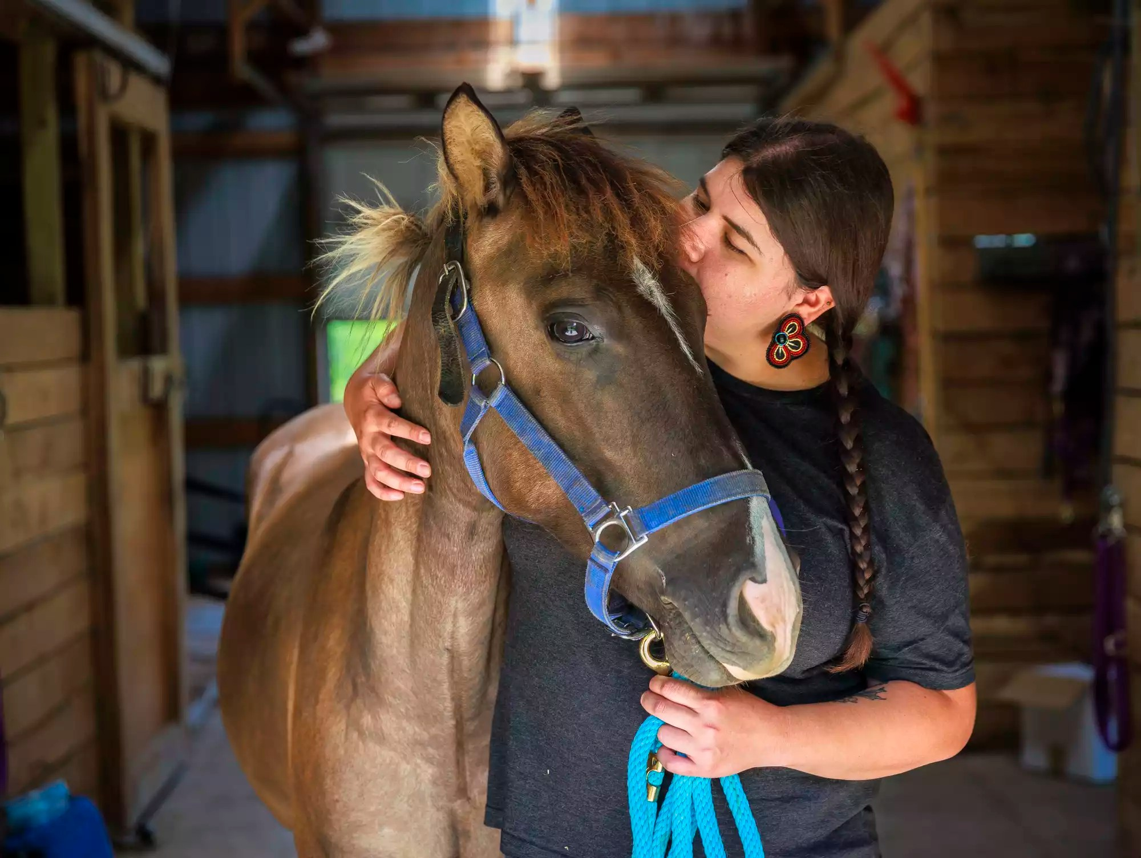
Equine & Land Based Healing
Baldwin Idea grant: Anishinaabe-Mishtadimoons Inawendiwin - Restoring and Awakening the Cultural and Ecological Context
Lac La Croix ponies rebounding from near extinction
Equine based healing to address trauma of violence survivors
Transdisciplinary collaboration between social work & nursing
Reconnecting our Anishinaabe relatives without more than huma relatives
Storytelling and preserving oral histories
(Pictured: Dr. Em Loerzel from the Humble Horse (community partner)
Notes:
Climate justice nursing addresses the social, racial, economic, environmental, and multispecies justice issues of the climate crisis through centering the lived experiences and knowledges of frontline communities and safeguarding the rights of Nature to achieve planetary health.

Slide 34
What can you do?
Allies and advocates, we need you!

Slide 35
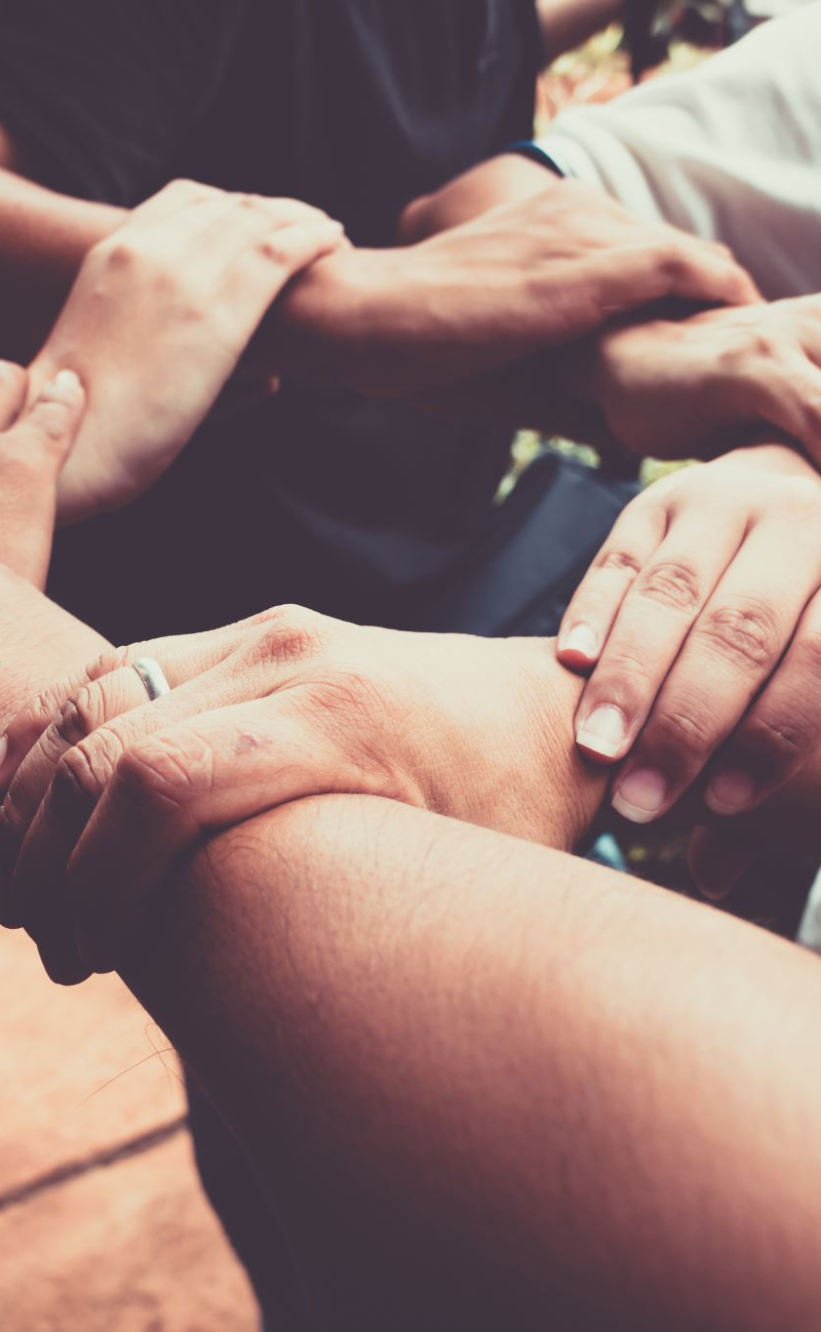
Allies and advocates
You’re here today! That’s a wonderful start to allyship and advocacy!
Raise awareness and help spread the word! May 5th is National Missing and Murdered Indigenous Women Awareness Day
Write to your legislators. Encourage them to support and pass the Violence Against Women’s Act & funding for a Wisconsin MMIW office
Stand up for victims and survivors of violence. We must be proactive to break the cycle of violence
Oppose energy policies that destroy Native lands and communities!
Non-Native allies and advocates are needed. We can’t do this alone!

Slide 36
Videos for Further Learning
Peace River Rising: https://youtu.be/6GbGL7dmEwA
The Search- MMIW: https://youtu.be/mdPv0NDfMbA​
Our Sisters in Spirit: https://youtu.be/zdzM6krfaKY​
Peace River Rising: https://youtu.be/6GbGL7dmEwA​
A Broken Trust- Sexual Assault on Tribal Lands: https://youtu.be/-slFVM4ECUk​
Silent No More: https://youtu.be/DdjXyUPXtZs​
Between the Lines: https://youtu.be/hOXyGJuRMmo​
Highway of Tears: https://youtu.be/xz63Vppw3gE

Slide 37
Questions?
Let’s talk!

Slide 38
references
Title slide: Shutterstock photo credit
Slide 3: www.theways.org
Slide 4: By Presidentman - Own work, CC BY-SA 4.0, https://commons.wikimedia.org/w/index.php?curid=81296942
Interactive map: https://native-land.ca
(WDHS)Wisconsin Department of Health Services (27 December 2017). American Indians in Wisconsin Overview. Retrieved from: https://www.dhs.wisconsin.gov/minority-health/population/amind-pop.htm
NSVIS study: https://www.cdc.gov/violenceprevention/nisvs/index.html
Red Sand Project: https://redsandproject.org

